Slide 1
Structure of an HTML Page

Slide 2
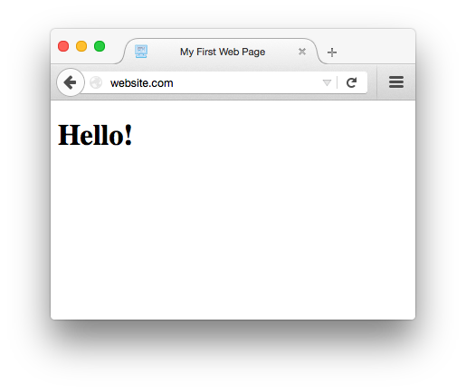
Example Web Page

Slide 3
Example Web Page
My First Web Page
Hello!
yourWebpage.html

Slide 4
Example Web Page
My First Web Page
Hello!
yourWebpage.html
Notes:
How do we tell the browser that we want that first line to be the title of the page, and that second line to be the text on the actual page?

Slide 5
Basic HTML Page
<!DOCTYPE html>
<html>
<head>
<title></title>
</head>
<body>
</body>
</html>

Slide 6
Basic HTML Page
<!DOCTYPE html>
<html>
<head>
<title></title>
</head>
<body>
</body>
</html>
Doctype tells the browser which version of HTML we are using.
This says we are using HTML 5.
(not an HTML tag)

Slide 7
Basic HTML Page
<!DOCTYPE html>
<html>
<head>
<title></title>
</head>
<body>
</body>
</html>
The <html> tag says everything in between these two tags is our html page.
Container for all other html tags.

Slide 8
Basic HTML Page
<!DOCTYPE html>
<html>
<head>
<title></title>
</head>
<body>
</body>
</html>
The <head> tag contains important information about the document:
metadata - data about data.
We can include a few special tags here.

Slide 9
Basic HTML Page
<!DOCTYPE html>
<html>
<head>
<title>My First Page</title>
</head>
<body>
</body>
</html>
The <title> tag defines the title of the webpage.
This is displayed in the top of the web browser.

Slide 10
Basic HTML Page
<!DOCTYPE html>
<html>
<head>
<title>My First Page</title>
</head>
<body>
</body>
</html>
The <body> tag is where the actual content of the document goes (text, images, etc).
This is where most of your HTML tags will go.

Slide 11
Important Points
Tags can go inside other tags
We use indenting to show the structure of the tags
The structure of an html document is a tree

Slide 12
Tags inside other Tags
<!DOCTYPE html>
<html>
<head>
<title></title>
</head>
<body>
</body>
</html>
The <head> tag and the <body> tag are inside the <html> tag
The <title> tag is inside the <head> tag

Slide 13
Indenting Shows Structure
<!DOCTYPE html>
<html>
<head>
<title></title>
</head>
<body>
</body>
</html>
Everything inside the <html> tag is indented.

Slide 14
Indenting Shows Structure
<!DOCTYPE html>
<html>
<head>
<title></title>
</head>
<body>
</body>
</html>
Everything inside the <html> tag is indented.
Everything inside the <head> tag is indented further.

Slide 15
Tree Structure
<!DOCTYPE html>
<html>
<head>
<title></title>
</head>
<body>
</body>
</html>
HTML
HEAD
BODY
TITLE

Slide 16
Tree Structure
<!DOCTYPE html>
<html>
<head>
<title></title>
</head>
<body>
<h1></h1>
</body>
</html>
HTML
HEAD
BODY
TITLE
H1

Slide 17
Tree Structure
<!DOCTYPE html>
<html>
<head>
<title></title>
</head>
<body>
<h1></h1>
<h1></h1>
</body>
</html>
HTML
HEAD
BODY
TITLE
H1
H1

Slide 18
Example Web Page
My First Web Page
Hello!
yourWebpage.html

Slide 19
Example Web Page
<html>
My First Web Page
Hello!
</html>
yourWebpage.html

Slide 20
Example Web Page
<html>
My First Web Page
Hello!
</html>
yourWebpage.html
Notes:
First we need to tell the browser to interpret all of this text as HTML

Slide 21
Example Web Page
<html>
<head>
My First Web Page
</head>
<body>
Hello!
</body>
</html>
yourWebpage.html

Slide 22
Example Web Page
<html>
<head>
My First Web Page
</head>
<body>
Hello!
</body>
</html>
yourWebpage.html
Notes:
Then we need to tell the browser which text is the head, information about the page, and which text is the body, the actual content of the page

Slide 23
Example Web Page
<html>
<head>
<title>
My First Web Page
</title>
</head>
<body>
Hello!
</body>
</html>
yourWebpage.html

Slide 24
Example Web Page
<html>
<head>
<title>
My First Web Page
</title>
</head>
<body>
Hello!
</body>
</html>
yourWebpage.html

Slide 25
Example Web Page
<html>
<head>
<title>
My First Web Page
</title>
</head>
<body>
Hello!
</body>
</html>
yourWebpage.html

Slide 26
Example Web Page
<html>
<head>
<title>
My First Web Page
</title>
</head>
<body>
<h1>Hello!</h1>
</body>
</html>
yourWebpage.html

Slide 27
Example Web Page
<html>
<head>
<title>
My First Web Page
</title>
</head>
<body>
<h1>Hello!</h1>
</body>
</html>
yourWebpage.html

Slide 28
Example Web Page
<html>
<head>
<title>
My First Web Page
</title>
</head>
<body>
<h1>Hello!</h1>
</body>
</html>
yourWebpage.html

Slide 29
Example Web Page
<!DOCTYPE html>
<html>
<head>
<title>
My First Web Page
</title>
</head>
<body>
<h1>Hello!</h1>
</body>
</html>
yourWebpage.html

Slide 30
Let’s see this in the editor!

